Slide 1
MODULE 1
Introduction of Japanese language and alphabets; Hiragana and katakana Reading and writing Hiragana and Katakana, 20 Nouns in Hiragana and 10 Nouns in Katakana, Numerals Basic rule of Japanese phonetics.

Slide 2
JAPANESE CHARACTERS
The Japanese writing system is composed of three scripts
Hiragana – 46 letters (41 consonants and 5 vowels – a, i, u, e, o)
For writing Native Japanese (Eg) ほん（Book)
Katakana - 46 letters (41 consonants and 5 vowels – a, i, u, e,o)
For writing Foreign language in Japanese (Eg) コーヒー（Coffee）
Kanji – More than 10,000 (Originated from china)
Pictorial representation with two readings Onyoumi (Chinese reading) and
kunyoumi (Jap reading)
女 ーWoman
子ーChild
男 ーMan

Slide 3
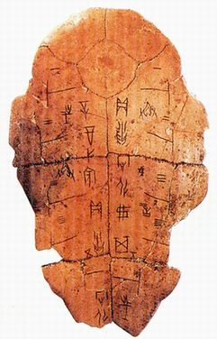
ORIGIN OF KANJI
Kanji was born around 3,300 years ago in China,
during the Shang dynasty or Yin dynasty.
It wasn’t even thought of as a writing system until the Zhou dynasty
People relied heavily on rain if they wanted to be able to harvest their crops and eat. So they turned to the Gods, and in order to understand their answers, they would practice pyromancy, they would burn turtle shells and bones of beasts, on which they would read the cracks that had formed and interpret them in order to predict the rain periods for example.
They would copy these cracks on non-burned turtle shells and try to find a meaning. These bones and shells which held those inscriptions were called oracle bones (甲骨文字, kōkotsumoji, in Japanese, which literally means “characters on carapaces/oracle bones”).

Slide 4
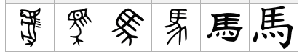
ORIGIN OF KANJI
Zhou dynasty took the Shang dynasty’s place and ruled the country. They discovered all these cracked carapaces and their interpretations by the people, and realized that it could be a way of communicating between people. A writing system!
They had the idea of using the characters (ideographs) that were once used to communicate with the Gods, in order to communicate with other clans, houses.
when the country was united and the Qin dynasty came into the game (around 221 B.C.) the writing system started to get codified and was now the same for the whole country for paper work
Evolution of Horse kanji

Slide 5
ORIGIN OF KANJI
Next, around the 6th to the 10th century AD, kanji evolved as people in China for faster and accurate writing, creation of printed style kanji
Kanji started to spread in Japan towards the end of the 4th century and the beginning of the 5th. Imported by Chinese immigrants via the Korean peninsula.
various Chinese words and vocabulary that were adapted to fit the Japanese pronunciation and Chinese adopted Japanese words into their vocabulary and influenced each other
For example, the word for telephone : 電話 is pronounced “denwa” in Japanese, and “diànhuà” in Chinese. In this particular case, the word was imported from Japan to China.

Slide 6
漢字（かんじ）
一 いち
ニ に
三 さん
四 よん・し
五 ご
六 ろく
七 しち・なな
八 はち
九 きゅう
十 じゅう

Slide 7
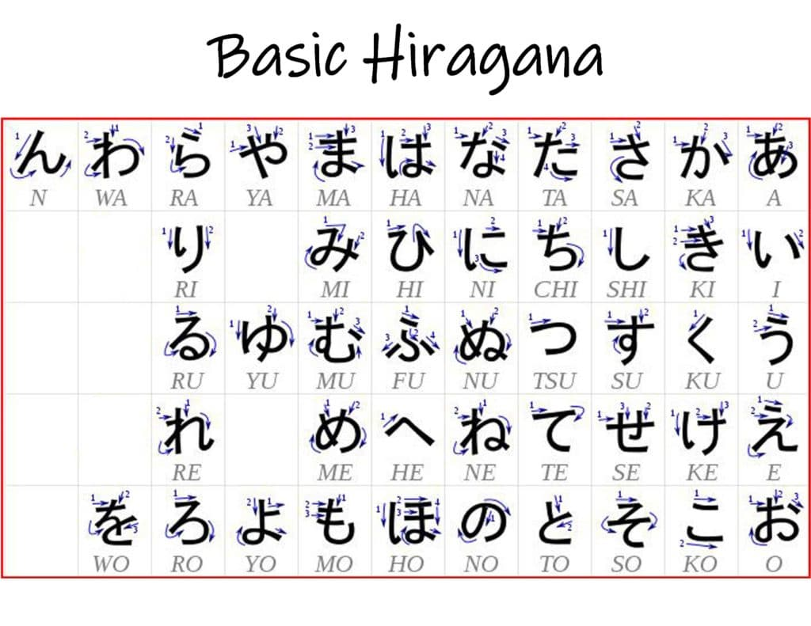
Hiragana- Chart 1

Slide 8
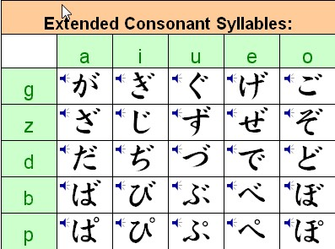
Hiragana- Chart 2
(Dakuten Chart)

Slide 9
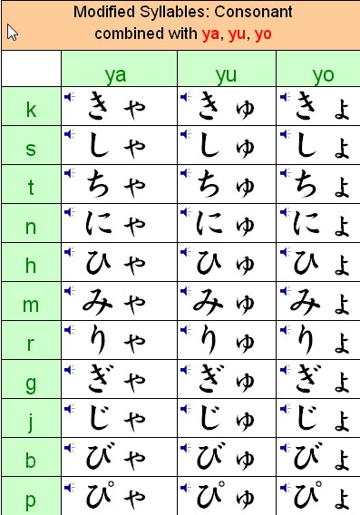
Hiragana- Chart 3
Combo Hiragana

Slide 10
20 Nouns of Hiragana
あいさつ：
O ha yo o go za i ma su ―
おはよう ございます
２． Ko n ni chi wa －こんにちは
３． Ko n ba n wa －こんばんは
４． A ri ga to u ― ありがとう
５． Su mi ma se n ―すみません
６． Sa yo u na ra ―さようなら
７． Ha i ―はい
I I e ―いいえ
O ya su mi na sa i- おやすみ なさい

Slide 11
20 Nouns of Hiragana
めいし（Nouns）
10．A sa - あさ -Morning
11．I e -いえ - House
12．Ya ma-やま - Mountain
13．So ra- そら - sky
14．Ne ko - ねこ - Cat
15．Yo ru -よる - Night
16.Tsu ku e -つくえ - Desk
17．Za s shi -ざっし- Magazine
18．Fu ji sa n - ふじさん – Mt.Fuji
19．To u kyo u -とうきょう – Tokyo
20. Te n pu ra – てんぷら – Fried item

Slide 12
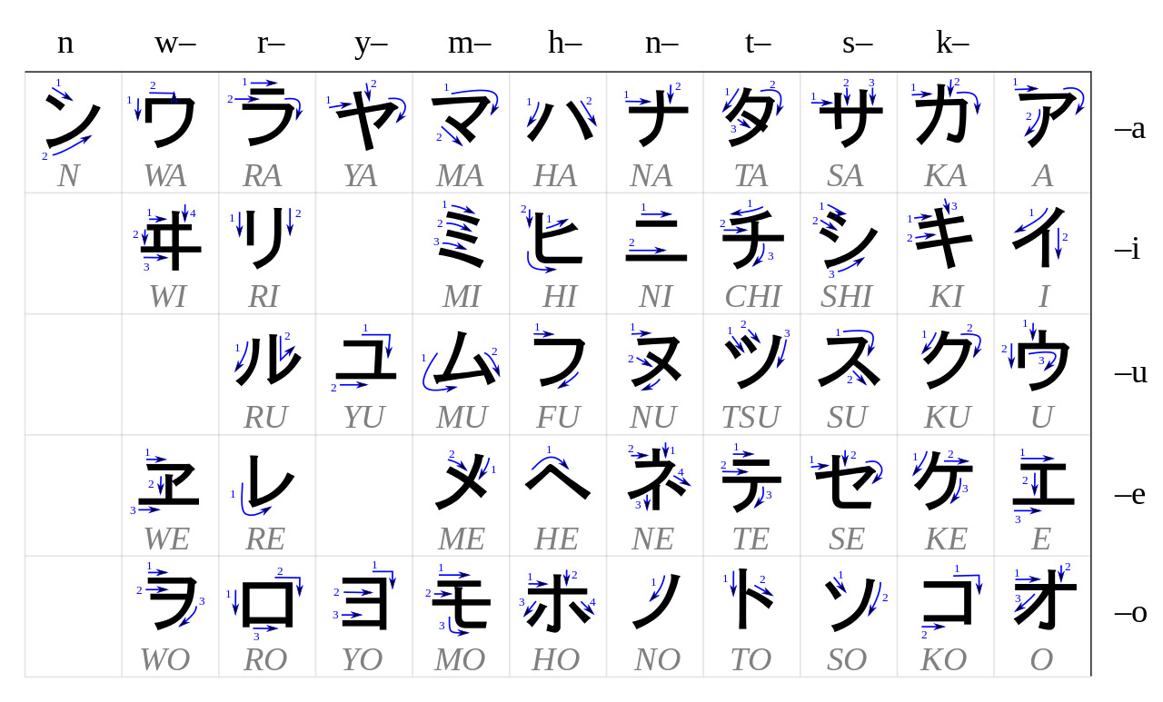
Katakana – Chart 1

Slide 13
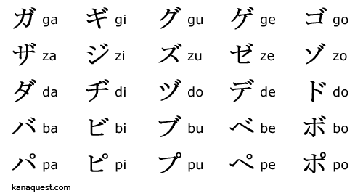
Katakana – Chart 2

Slide 14
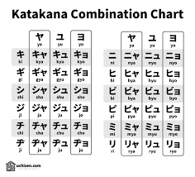
Katakana – Chart 3

Slide 15
10 Nouns of Katakana
Pa n - パン - Bread
Te re bi - テレビ - Television
Ka me ra - カメラ - Camera
To i re -トイレ - Toilet
So fa -ソファ - Sofa
Be d do -ベッド - Bed
Sha tsu - シャツ - Shirt
Ko o hi i-コ－ヒ－ - Coffee
Ju u su- ジュ－ス – Juice
E a ko nエアコン- Air conditioner

